Slide 1
Never Science Alone with Project-Based Instruction
KATS Kamp 2018
Laurie Cleavinger

Slide 2
KU School of Education
Preparing Educators as Leaders
College of Liberal Arts & Sciences

Slide 3
Project-Based Instruction
The problematic situation is presented first and serves as the organizing center and context for learning
It is open-ended
It is an application of the content
It may change with the addition of new information
It is not solved easily or with a specific formula
It does not have one right answer

Slide 4
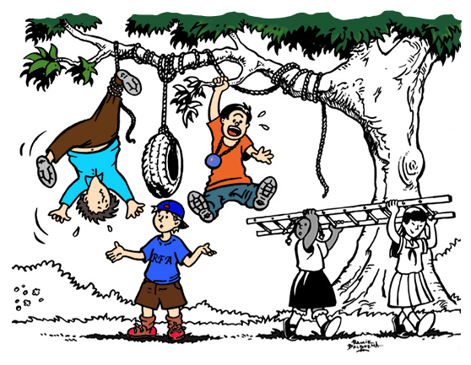
Project-Based Instruction
Students are active problem solvers and learners
Teachers are cognitive and metacognitive coaches
Assessment is an authentic companion to the problem and process

Slide 6
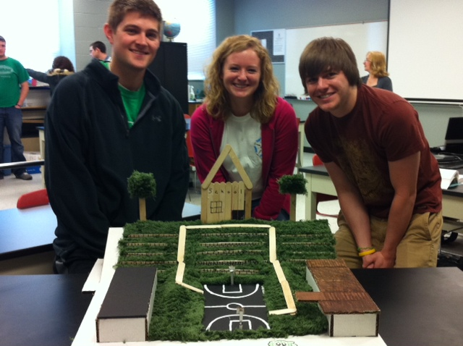
Addressing the Standards
Driving Question
Final Product
Rubric
Ongoing assessments and checkpoints

Slide 7
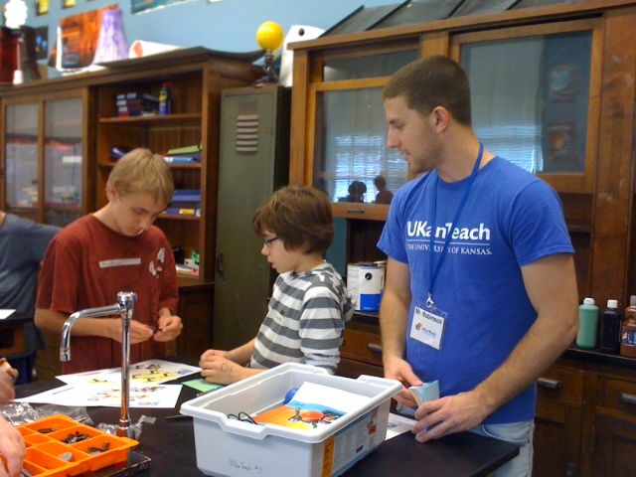
Driving Question
Feasible
Contextualization
Worth**
Meaning
Sustainable
Ethical

Slide 8
Driving Question
How can we use math to understand the motion of the solar system?
HS-ESS1-4 EARTH’S PLACE IN THE UNIVERSE: Use mathematical or computational representations to predict the motion of orbiting objects in the solar system

Slide 9
Math
Science
M4. Models with mathematics
S2: Develop & use models
S5: Use mathematics & computational thinking
M1: Make sense of problems and persevere in solving them
M2: Reason abstractly & quantitatively
M6: Attend to precision
M7: Look for & make use of structure
M8: Look for & make use of regularity in repeated reasoning
S1: Ask questions and define problems
S3: Plan & carry out investigations
S4: Analyze & interpret data
S6: Construct explanations & design solutions
E2: Build a strong base of knowledge through content rich texts
E5: Read, write, and speak grounded in evidence
M3 & E4: Construct viable arguments and critique reasoning of others
S7: Engage in argument from evidence
E6: Use technology & digital media strategically & capably
M5: Use appropriate tools strategically
S8: Obtain, evaluate, & communicate information
E3: Obtain, synthesize, and report findings clearly and effectively in response to task and purpose
E1: Demonstrate independence in reading complex texts, and writing and speaking about them
E7: Come to understand other perspectives and cultures through reading, listening, and collaborations
Based on work
by Tina Chuek
ell.stanford.edu
ELA

Slide 10
Standards | Lesson 1 | Lesson 2
M4: Model with mathematics
CCSS.MATH.CONTENT.HSG.GPE.A.3 – Derive the equations of ellipses and hyperbolas given the foci, using the fact that the sum or difference of distances from the foci is constant.
E6: Use technology and digital media strategically and capably
S8: Obtain, evaluate, and communicate information
HS-ESS1-4 EARTH’S PLACE IN THE UNIVERSE: Use mathematical or computational representations to predict the motion of orbiting objects in the solar system

Slide 13
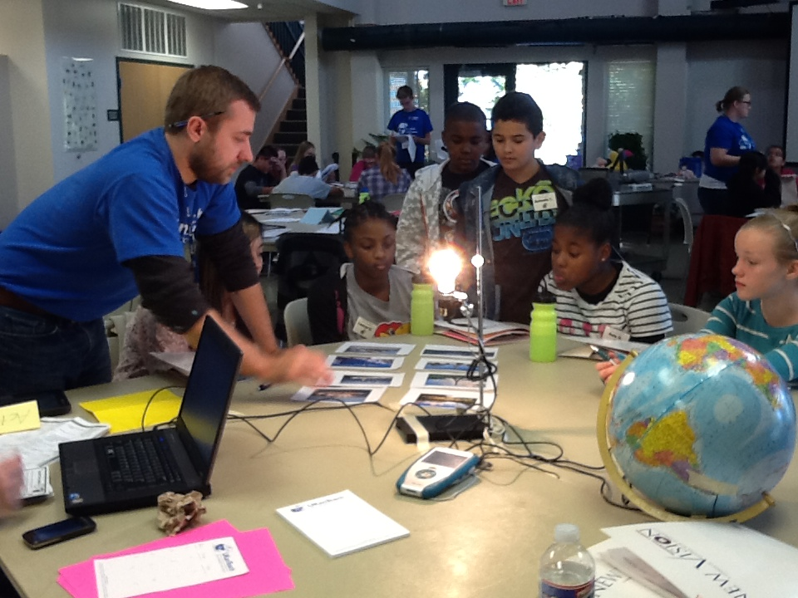
Critical Thinking

Slide 14
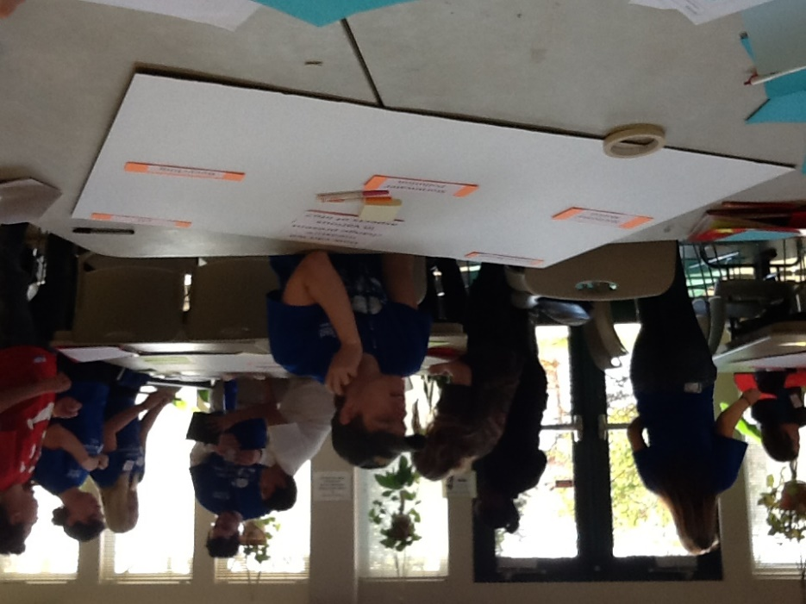
Communication

Slide 15
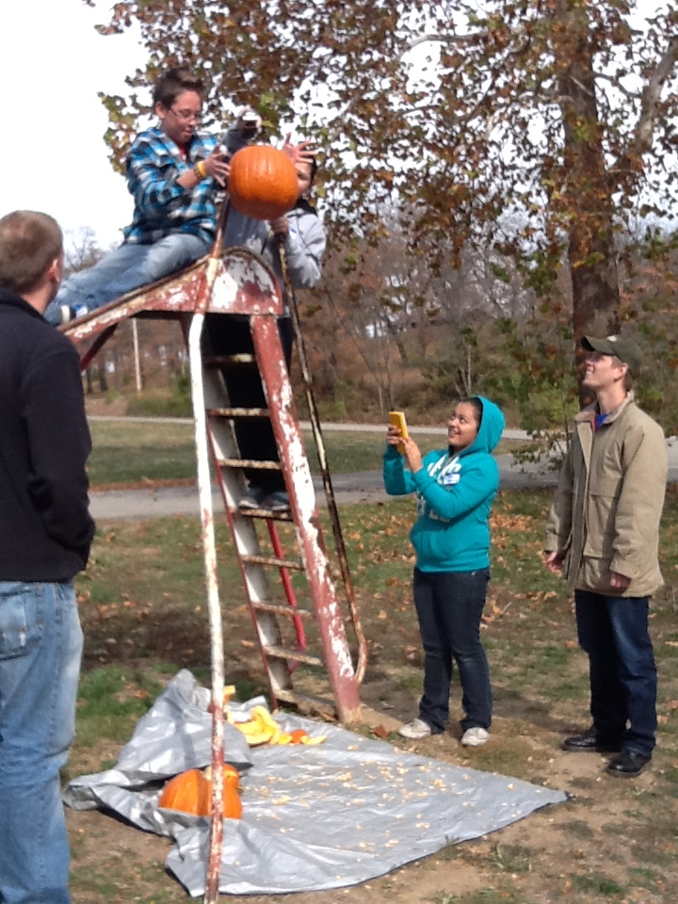
Collaboration

Slide 16
Creativity

Slide 17
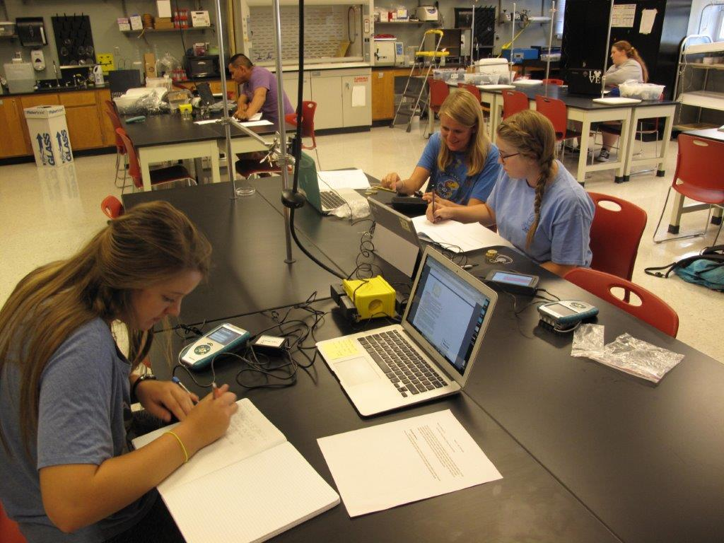
Technology

Slide 18
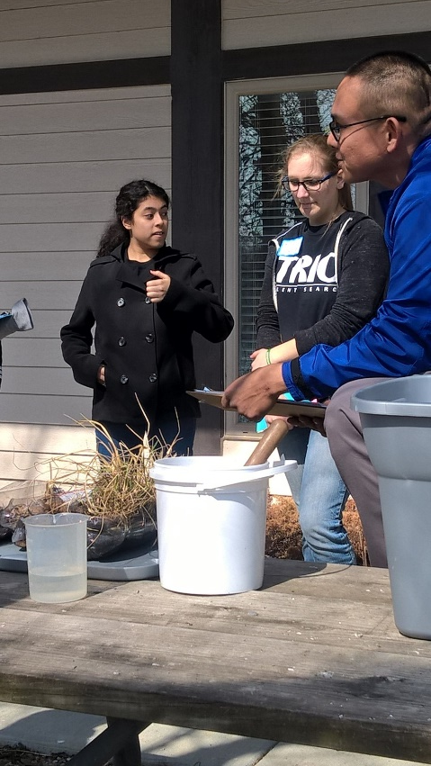
Never Science Alone
PBI
Science
Math
ELA
21st Century Skills

Slide 20
Questions?
Laurie Cleavinger
cleavingerl@ku.edu

